Slide 1

Prepared by:
Mahmoud Ehab Mahmoud Abdeen.
Ahmed Khaled Mohana Tohamy.
Mariam Mohamed Abdelmonem Ismail.
Under supervision of
DR/Manal showman

Slide 2



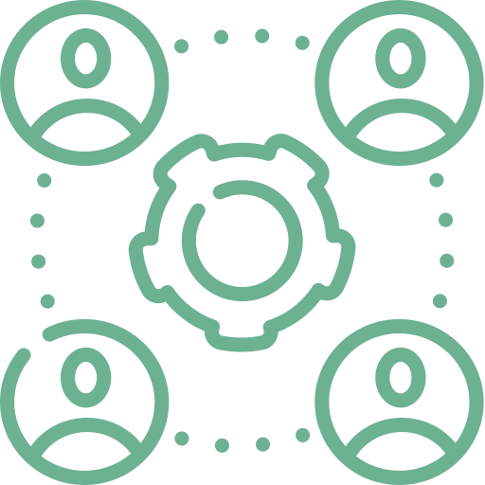

Non-fun.
Introduction
Modules
Diagrams
Log out

Slide 3
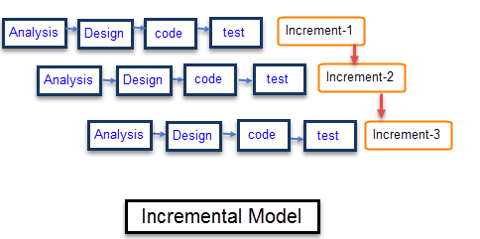
Process Model

Slide 4





Work plan
Requirements
11
12
1
Deployment
10
2
9
3
Planning
8
4
7
5
6
Construction
Design & analysis

Slide 5
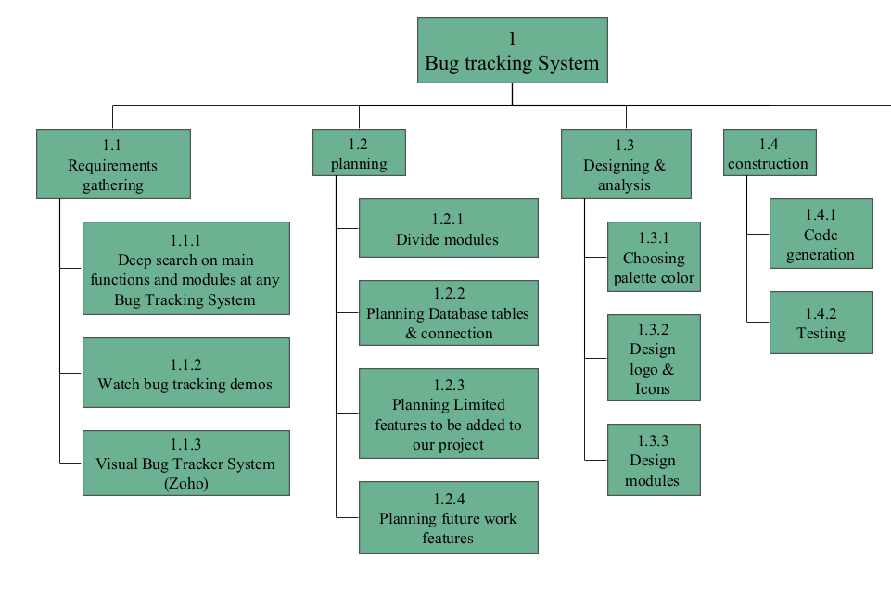

Slide 6
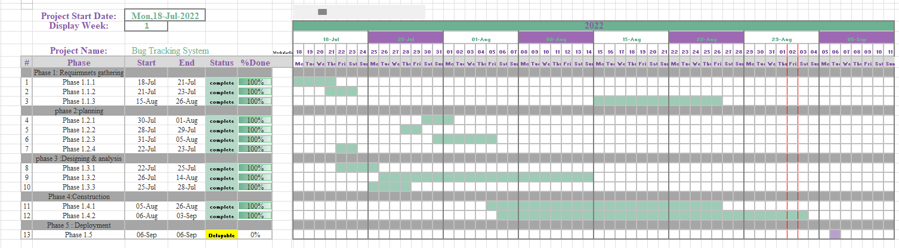

Slide 7

Application flow
Tester checks the solution of the developer & changes bug status from To be tested into Closed
STEP
05
STEP
Developer solves the assigned bugs and changes its status from in progress into To be tested.
04
Administrator assigns bugs to specific developer
STEP
03
STEP
Tester starts reporting bugs
02
Administrator creates project & assign users to this project
STEP
01

Slide 8
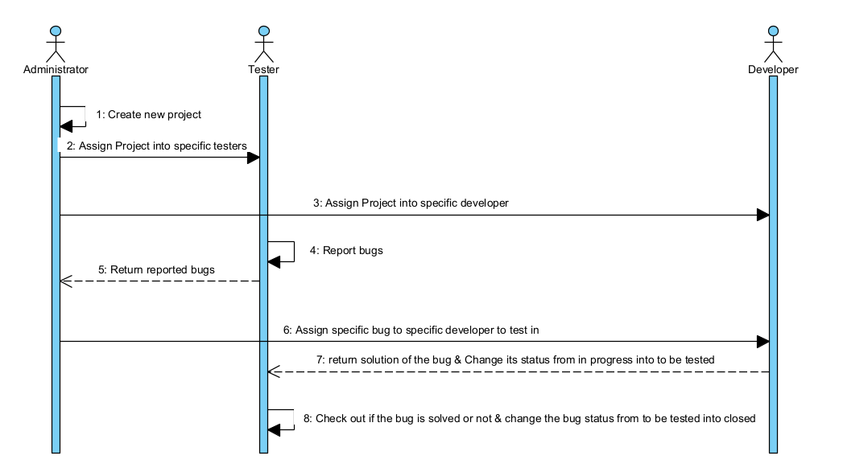

Slide 9
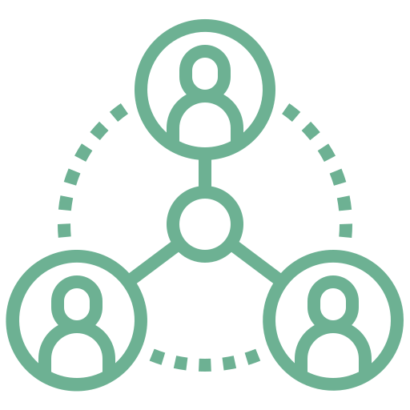


Introduction
Purpose
Stakeholders
End Product
purpose of the software is to track bugs and allow the end user to manage bugs and store them if they ever appear in other projects.
Administrator.
Developer.
Tester.
Desktop Application

Slide 10

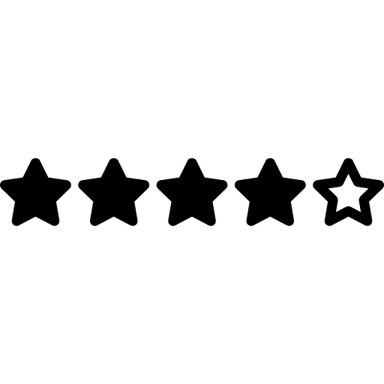





Modules:
Intro
Rating
Check the usability of the application
Loading page
Login Page
Tester
Bug Tracking System
The gateway to users profile.
Responsible for discovering bugs
Developer
Administrator
Responsible for solving bugs
Monitors and maintain the system

Slide 11
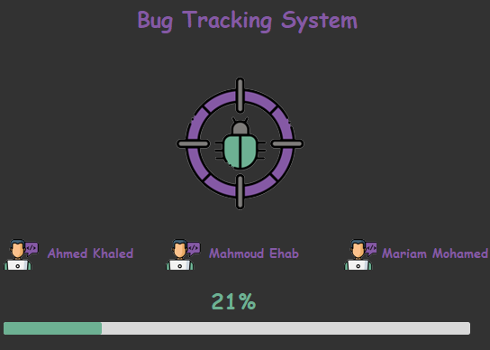
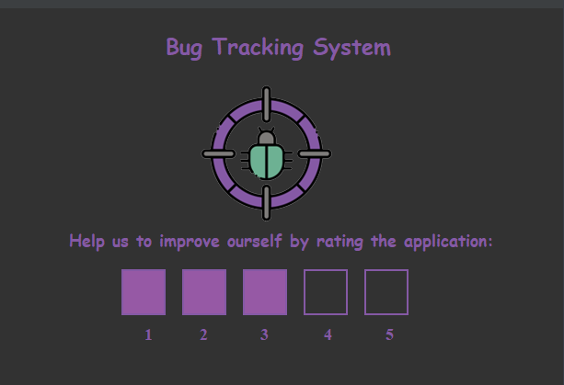
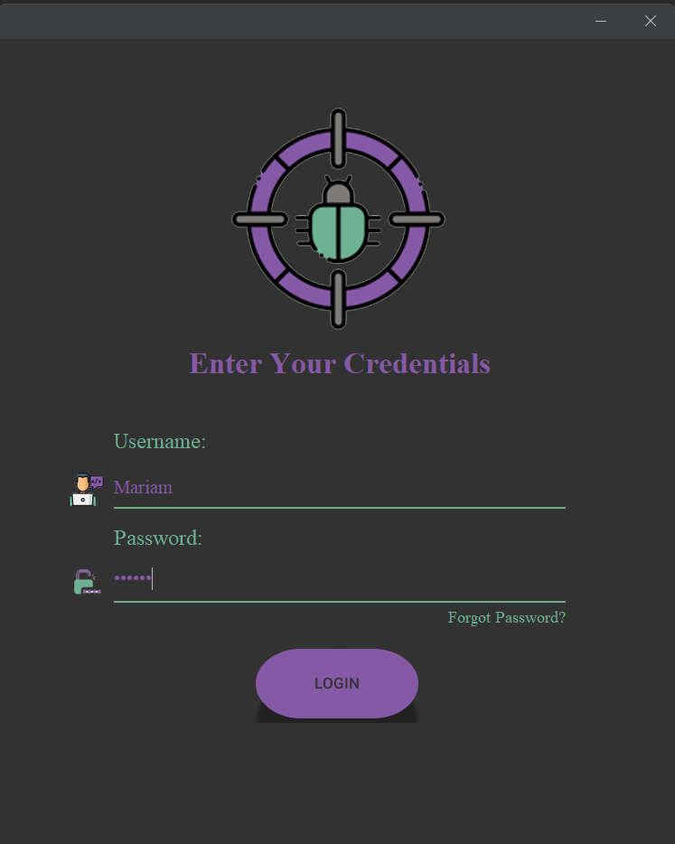
Main modules
Intro
Rating
Login

Slide 12
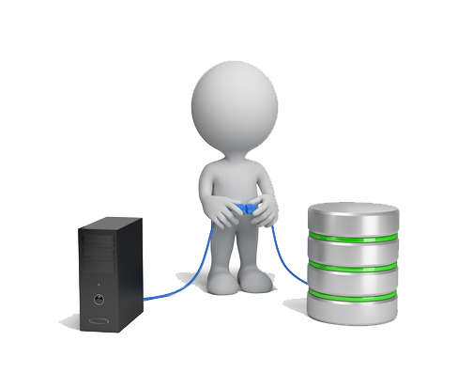


Modules
Administrator
Login page
Tester
Developer

Slide 13
Login page
The gateway to user profiles.
Prevents unauthorized access.
Notifies the administrator when a password reset is needed.

Slide 14
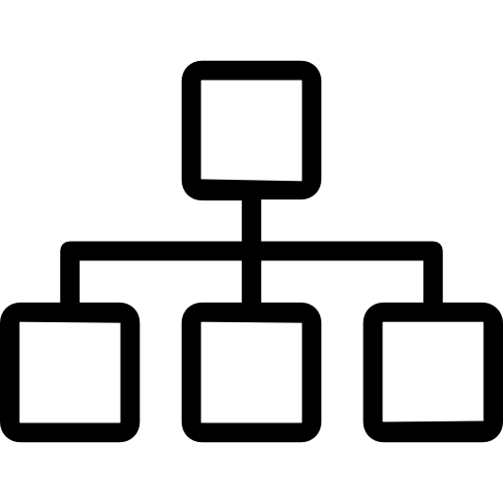

Login page functional requirements
Right credentials:
1
If the credentials are right , user’s module will appear
Wrong credentials:
2
You have only 5 trials for login before the application stops working.
Forgot Password:
3
If the user forgot his password , he could ask for a new one.

Slide 15
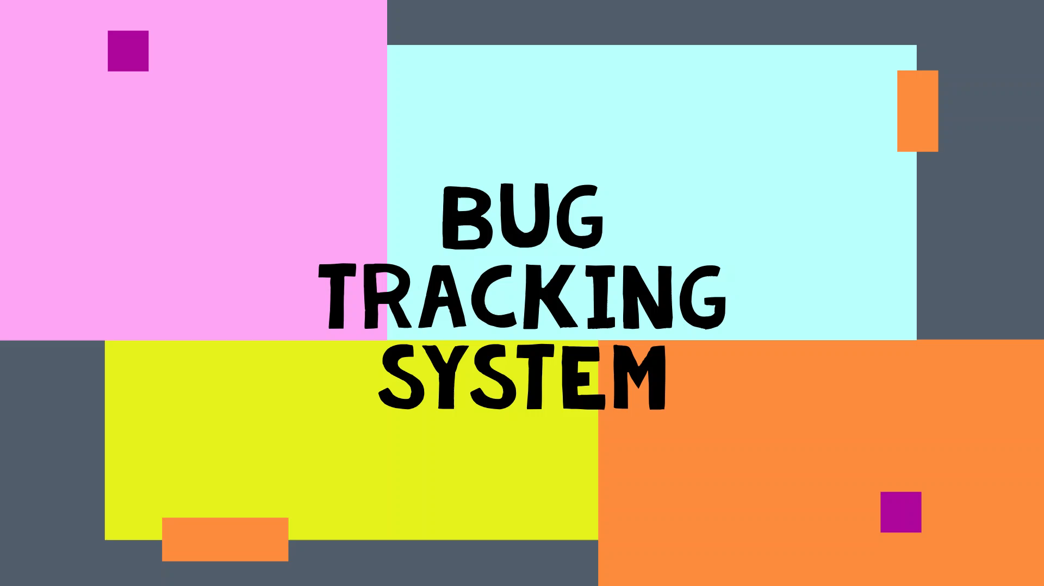

Slide 16
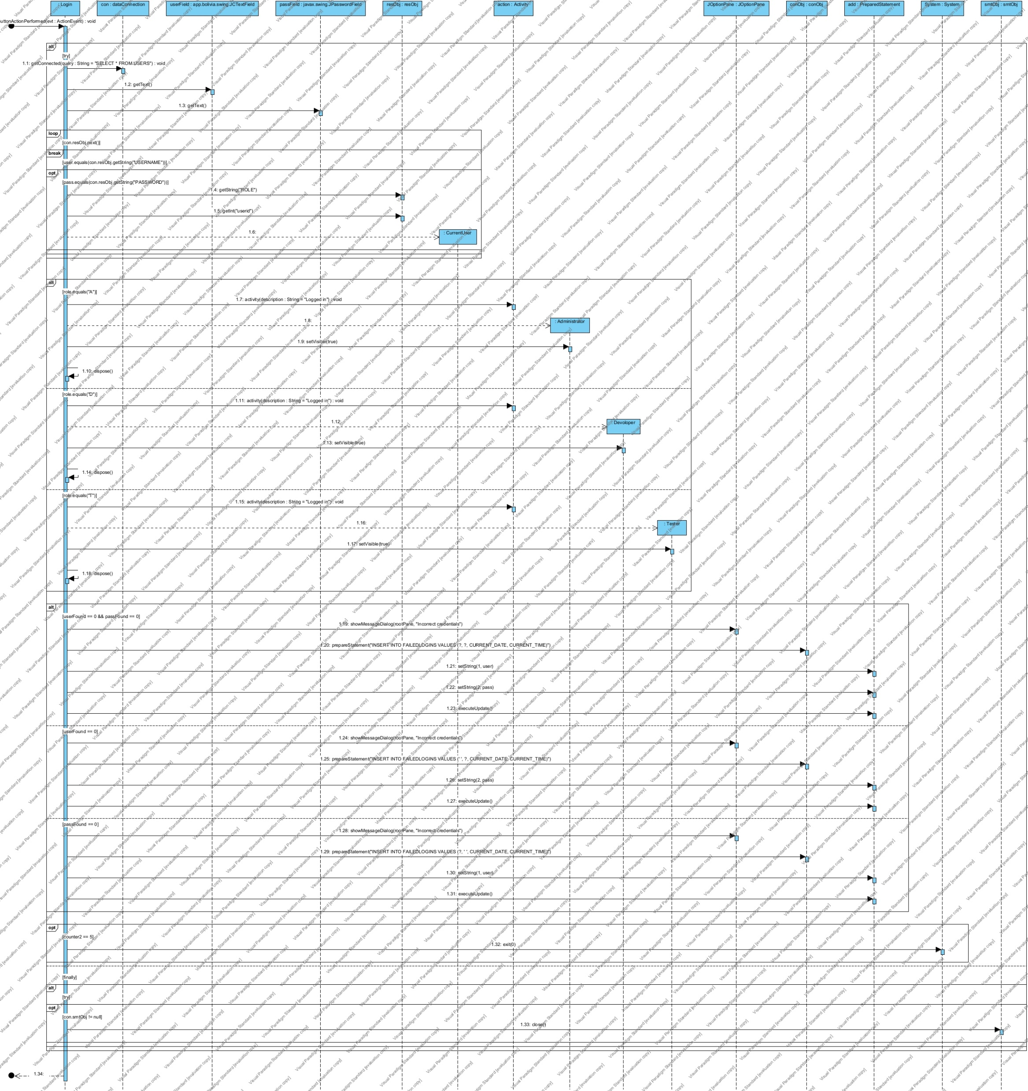
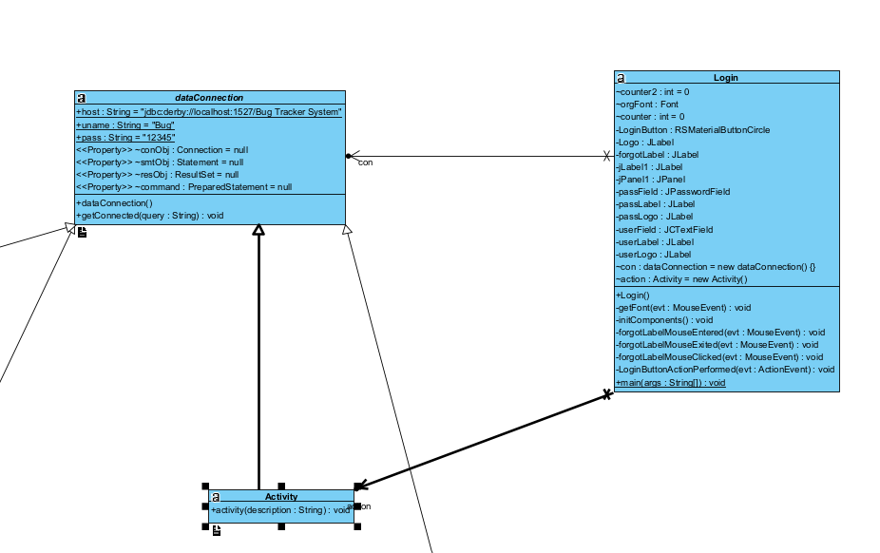

Slide 17
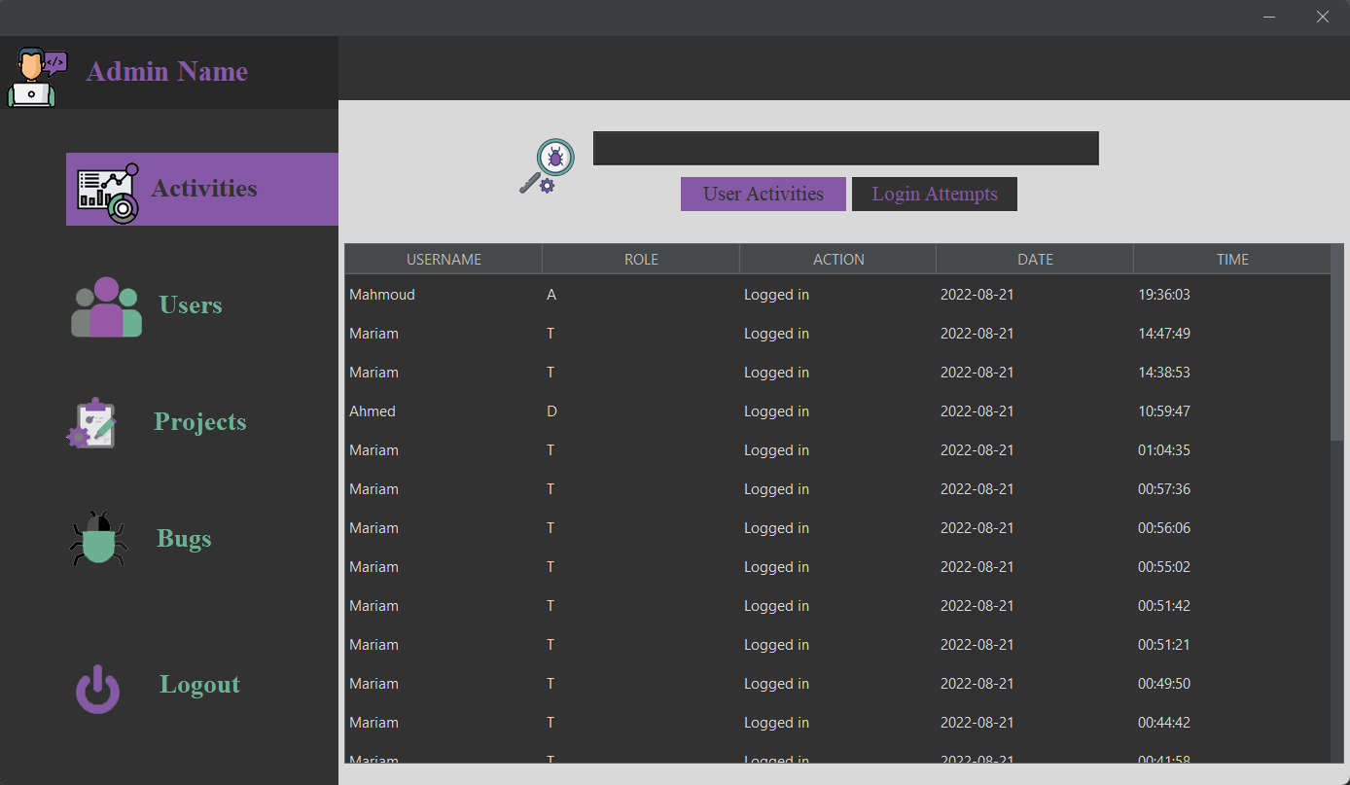
Administrator
Monitors and maintains the system.
Adds new users.
Edits and deletes user information.
Creates projects.
Updates and terminates projects.
Adds bug information.

Slide 18
Administrator page functional requirements
View activity table & login attempts table & search through these tables:
Create projects & assign it to users:
1-4
13-14
Only the administrator can add a new project to the system and assign it to different users.
The administrator can view the activity of other users & also can view requests of changing passwords. Surly he can search through these tables.
View user table & search through it:
Update project information & delete project:
5-6
Only the administrator can view the whole users in the system & view the details of any user. Surly he can search through this table.
15-16
Only the administrator can update & delete project information.
Add new users , update their details & delete user:
View bug table & search through it:
7-9
Only the administrator can add a new users to the system with their details & have the access to update or delete these details user.
17-18
The administrator can view the whole bugs in the system with its details. Surly he can search through this table.
Delete users:
19-20
Update bug severity & type & assign it to specific developer:
10
The administrator can delete all the users in the system.
The administrator can update bug severity , type & status.
View projects table & search through it:
21
View rate table:
11-12
Only the administrator can view the whole projects in the system with its details. Surly he can search through this table.
The administrator can view the rate table.

Slide 19


Slide 20
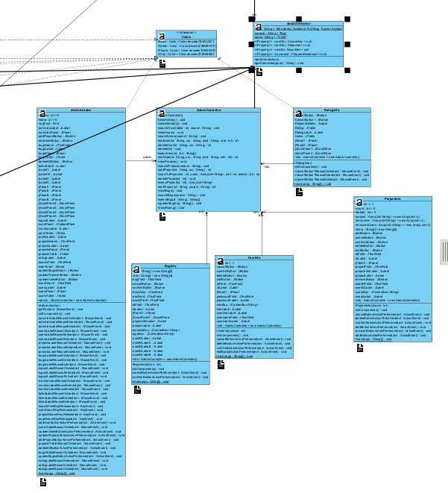
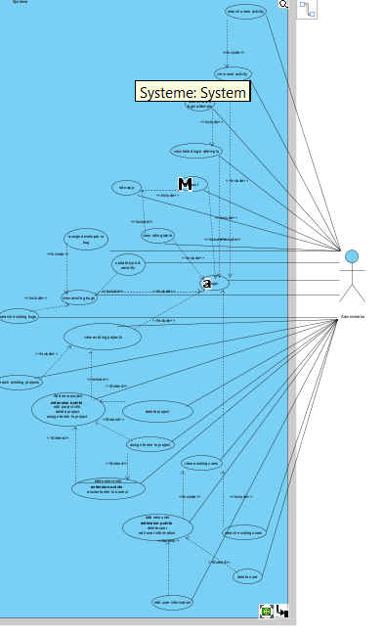

Slide 21
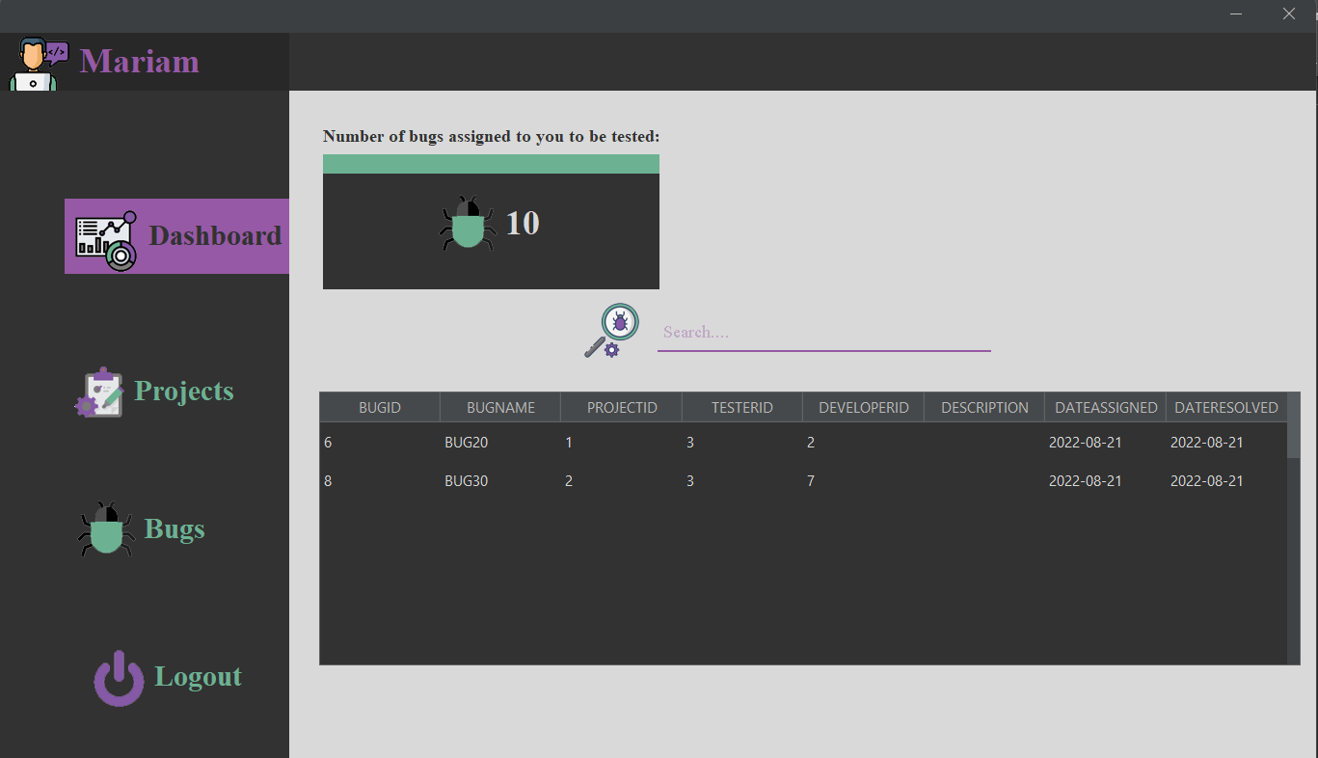
Tester
Responsible for discovering bugs.
Views assigned projects.
Adds bug reports to the system.
Checks added bugs status.

Slide 22
Tester page functional requirements
View Assigned bugs table & search through it:
1-2
The tester can view a table of assigned bugs that its status is to be tested and needs to be completed. Surly he can search through this table.
Report a bug:
9
Only testers have the access to add new bug in a specific project.
Update bug status:
3
Testers can update bug status from to be tested into closed.
10
Update bug details:
View assigned Projects table & search through it:
Testers can update bug information ( severity , type , description) of a specific bug.
4-5
The tester can view a table of assigned projects which have been assigned by the administrator . Surly he can search through this table.
Delete bug:
11
Only the testers have the access to delete a bug from a specific project.
.
View other users in the same project:
6
The tester have the access view the other assigned users in the same project to make the communication between them smooth , easy & simple.
12
View a pie chart of bugs status in specific project
Only testers have the access to view an overview pie chart of bugs status in a specific project
.
View bug table of a specific project & search through it:
7-8
The testers have the access to view bug table of a specific project. Surly he can search through this table.

Slide 24
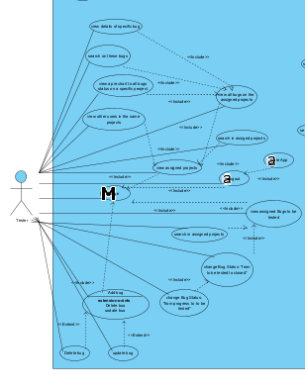
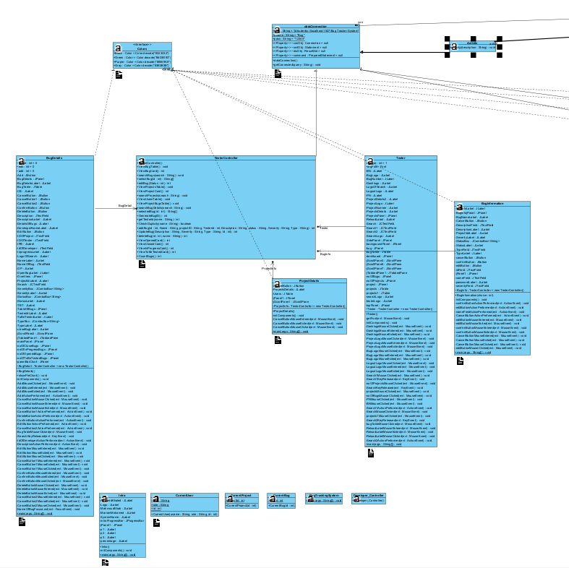

Slide 25
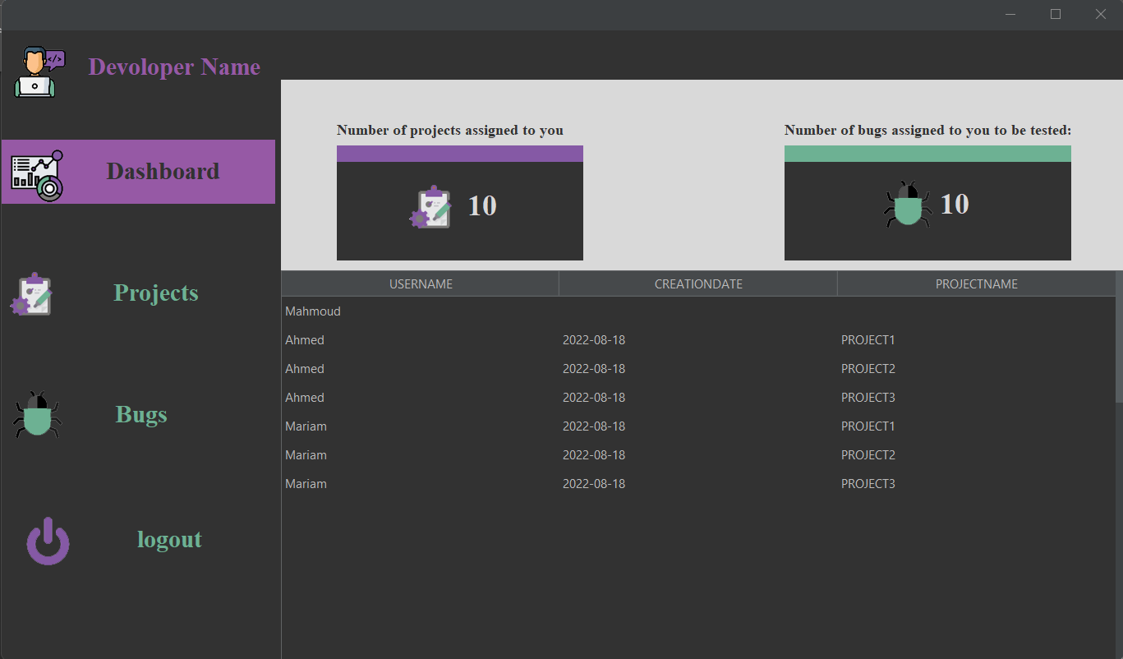
Developer
Responsible for solving bugs.
Views assigned projects.
Updates assigned bugs status.
Changes profile password.

Slide 26
Developer page functional requirements
Reset password:
1
Only developers has the access their passwords ,but the administrator will receive a notification when this action happens.
View Assigned bugs table & search through it:
2-3
The Developer can view a table of assigned bugs that its status is in progress and needs to be completed. Surly he can search through this table. Surly he can search through this table.
Update bug status:
4
Developers can update bug status from in progress into to be tested.
View assigned projects table & search through it:
5-6
The developer can view a table of assigned projects which have been assigned by the administrator . Surly he can search through this table.
View all assigned bugs table regardless to its status:
7
The developer can view a table of assigned bugs regardless to its status & it’s used as a reference.

Slide 27


Slide 28
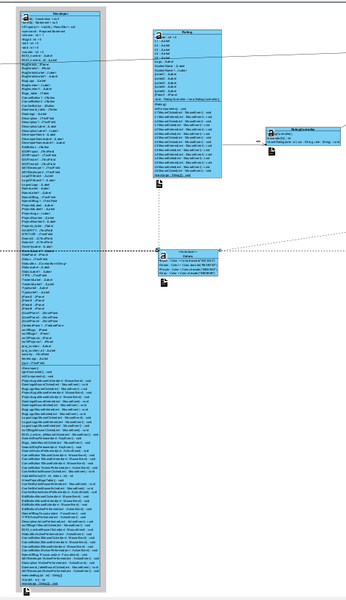
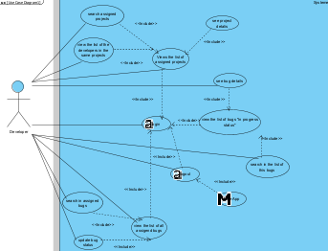

Slide 29
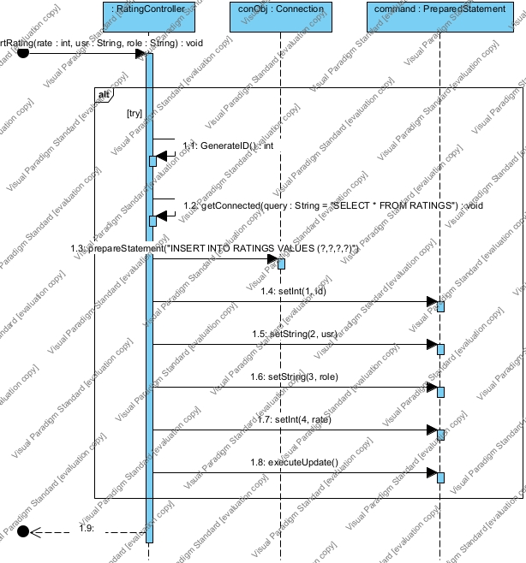
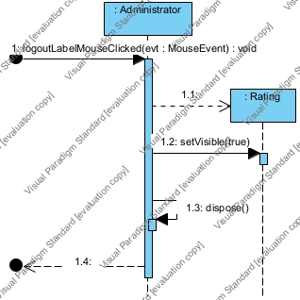
Logout & Rate diagrams

Slide 30
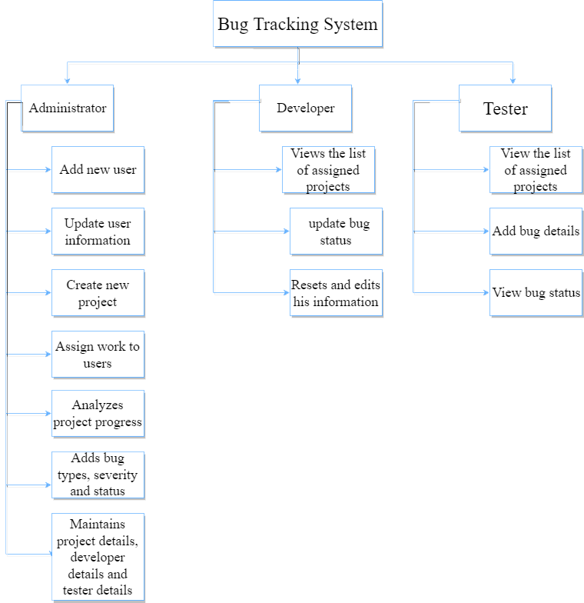
Abstract

Slide 31






Non-Functional requirements
Security:
Availability
Usability
portability
Maintainability
The system is a desktop application can run on several operating systems.
The system consists of modules every module consists of classes in order, so the system is easy to maintainable.
No one can access the system from outside the company
The system is easy to use, and the modules are so simple
The system should be available during working times

Slide 32
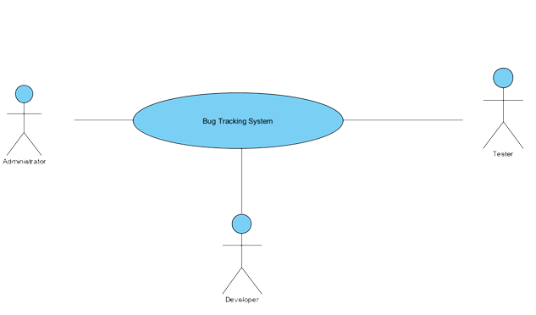
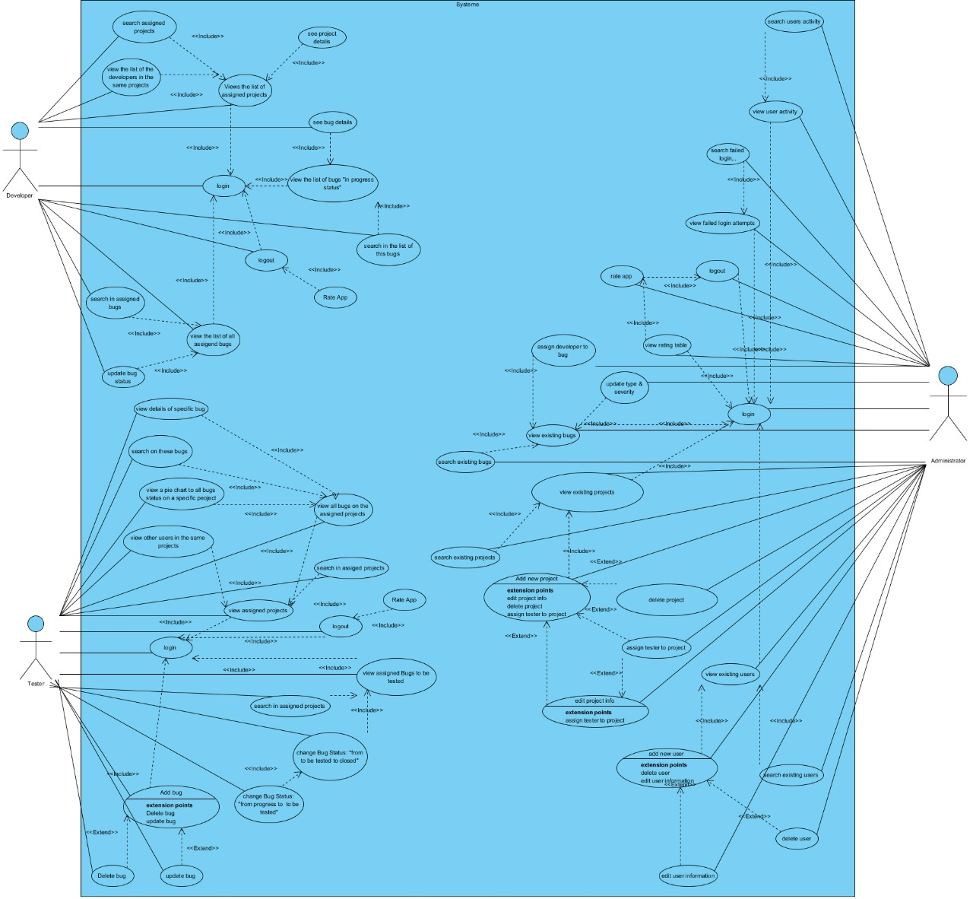
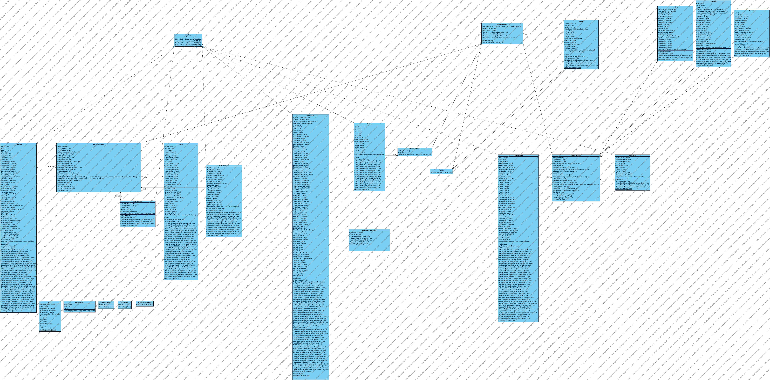

Slide 33


